Slide 1
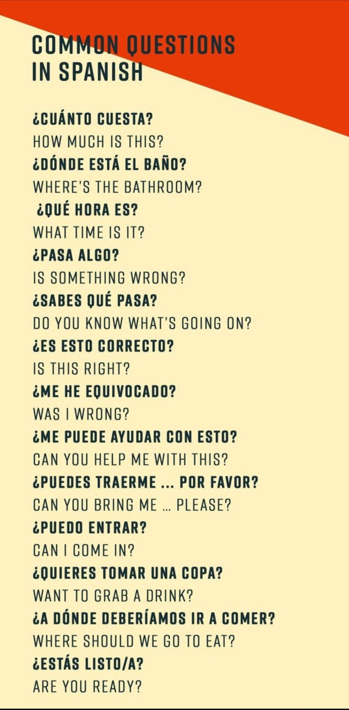
Cuesta is 3rd person singular of Costar
Pasar means “to pass” or “to happen”. “Algo” means “something”.
Saber means “to know”. Interesting to have two verbs in a short sentence.
“Equivocar” means “to get wrong”. “He equivocado” is present perfect of “equivocar”. “He” is present perfect of “Hacer”. “Equivocarse” is reflexive and means “to make a mistake” (used with reflexive pronoun “me”).
“Audarse” is reflexive and means “to help oneself”.
“Deber” means “should” or “to owe”. Very complex structure!!!

